Slide 1
Burden Reduction
Approach for Achieving Conformance

Slide 2
Expectations of the rule

Slide 3
CMS 0057-F Prior Authorization API
Impacted payers:
Medicare Advantage (MA) organizations
State Medicaid and (CHIP) Fee-for-Service (FFS) programs
Medicaid managed care plans
CHIP managed care entities
Qualified Health Plan (QHP) issuers on the Federally Facilitated Exchanges (FFEs)
Enforcement date: Jan. 1, 2027
FHIR API Requirements
What’s covered (items and services)
Documentation requirements for PA
PA Request and response
Is it approved? (with expiration date/conditions)
Is it denied? (with reason)
Is more information needed?

Slide 4
EHR Requirements
Applies to:
MIPS eligible clinicians & hospitals, critical access hospitals
Enforcement date: 2027 reporting period
Requirement
Must request prior authorization electronically via the PA API for at least one non-drug item/service
Could report an exclusion
Required technology (Payers and EHRs)
FHIR 4.0.1, US-Core 3.1.1, OpenID Connect Core 1.0, SMART app launch 1.0
Recommended technology
CRD 2.0.1, DTR 2.0.0, PAS 2.0.1
Notes:
While CRD, DTR, and PAS aren’t mandated, signals from CMS have hinted they may be mandated in the future.
There are no other FHIR guides that cover the needed functionality

Slide 5
What to do first?
CRD, DTR, PAS are all complex
Largely independent
If possible, work on all three in parallel
Most critical (covers largest part of the reg) is PAS

Slide 6
CRD
Approach to Achieving Conformance

Slide 7
CRD Regulatory Objectives
Primary objective:
Answer the question “What’s covered?”
Secondary objective:
Flag that additional information is necessary (cue DTR)
Flag that prior authorization is necessary (cue PAS)
Tertiary objective
Grant prior authorization if you can

Slide 8
What’s needed
Must support Coverage Information hook
Required hooks:
order-sign
Most useful for clinicians
Most challenging
Most diverse types of input
Most orders at once
Highest chance of missing information
Start on this first?
order-dispatch
If you can do order-sign, you can do this
appointment-book
Simplest (only a couple of input patterns)
More information known

Slide 9
Returning a response
For Reg conformance
Be able to figure out who the member is and if their coverage is active
Evaluate if the billing code is covered
Can indicate more info is needed (performing provider, more detailed code, specific timeframe, DTR questions)
For IG conformance
Map clinical codes to probable billable code
Evaluate if prior auth is needed
or indicate more info needed
Recommended approach
Provide answers for the easy things, punt to DTR when it gets complicated
Get smarter over time

Slide 10
Other considerations
Response time requirement is tight
May need to support other hooks for caching purposes
Integration between CRD & DTR
CRD can establish context for later DTR calls
Real-time prior auth in CRD is a goal
But not required to meet Jan 1, 2027 deadline
Expect the expectations for how much you do in CRD to grow over time

Slide 11
DTR
Approach to Achieving Conformance

Slide 12
DTR Regulatory Objectives
Primary objective:
Complete appropriate questionnaires (“forms”) according to Payer rules
Secondary objective:
Pre-populate forms as much as possible
Bundle documentation for downstream use (cue PAS)
Tertiary objective
Grant prior authorization if possible

Slide 13
What’s needed
DTR Client Application (“app”):
SMART on FHIR
EHR provided “native” app
Questionnaire processing support:
Standard single questionnaire paradigm
Adaptive questionnaire iterative paradigm
Clinical Quality Language (CQL)
Method to extract EHR data for pre-population of form
Libraries are central:
Developed and provided by Payer
Executed by client

Slide 14
DTR $questionnaire-package
Retrieves “package” of necessary Questionnaires, QuestionnaireResponses, CQL libraries, and Value sets
Invoked with a 'POST' using the base endpoint associated with the coverages provided.
POST [base]/$questionnaire-package
Input parameters:
Coverage is required (CRD profiled)
Will have at least…
The canonical (url) for a specific Questionnaire
One or more Request/Encounter resources
A context ID from CRD or PAS

Slide 15
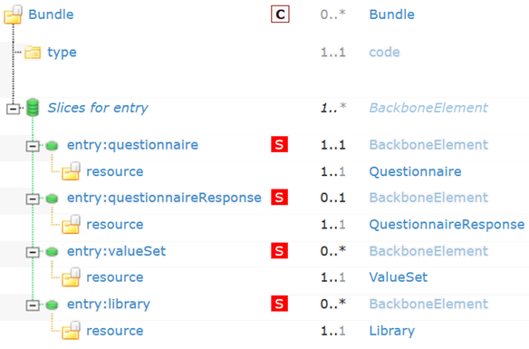
DTR Questionnaire Support
Determining ‘Standard’ or ‘Adaptive’ Paradigm
$questionnaire-package operation
DTR Questionnaire Package Bundle
Returns
Questionnaire Package Bundle
Questionnaire
Contains
questionnaireAdaptive
Extension?
Yes
No
DTR Standard Questionnaire
(dtr-std-questionnaire)
DTR Questionnaire for
adaptive form Search
(dtr-questionnaire-adapt-search)

Slide 16
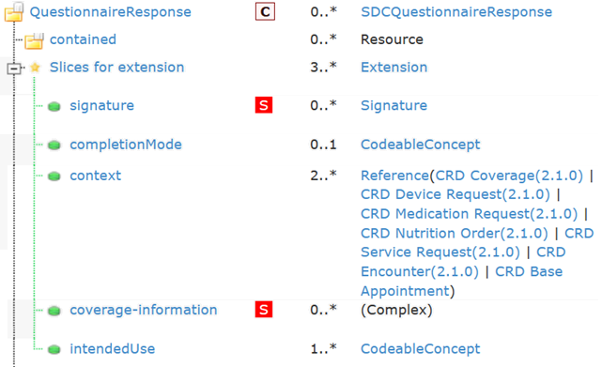
DTR Adaptive Processing
Process Flow for Adaptive Forms (Questionnaires)
Questionnaire conformant to AdaptiveQuestionnaire-Search
profile
(Supplies base url for $next-question)
DTR QuestionnaireResponse
$next-question operation
(Input: QuestionnaireResponse resource)
Returns
QuestionnaireResponse
resource
Extract Questionnaire as contained resource
Questions
exist?
Yes
Render and process
question(s)
No
Complete

Slide 17

DTR Process Completion
A completed QuestionnaireResponse must be saved to the EHR!
An EHR using a DTR Native App can use its own process for this
In the case of a DTR client SMART App, this is done RESTfully
Note that DTR Clients must be able, at any point, to save a QuestionnaireResponse as ‘in-progress’ for resuming later
A completed QuestionnaireResponse that is sent ‘downstream must be bundled in a Bundle of type ‘collection’ which conforms to the questionnaireResponseBundle profile
QuestionnaireResponse.status = ‘completed’

Slide 18
Other considerations
Integration between DTR & CRD:
Independent yet CRD is predominant launch source
Integration between DTR & PAS:
PAS implementation can leverage CDex to launch DTR
Capturing Metrics:
Required in regulations
Supported by the DTR Metric Data logical model

Slide 19
PAS
Approach to Achieving Conformance

Slide 20
PAS Regulatory Objectives
Primary objective:
Receive an answer to “do I have authorization to do this?”
When combined with CRD and DTR, efficiency will be increased because providers will know if authorization is needed and what information is required to be included to make the authorization decision
PAS IG provides a means for EHRs to send authorization requests using FHIR that will normally be converted to X12 278.
CMS has granted an exception that allows providers and payers to use PAS FHIR Bundles without conversion to X12

Slide 21
PAS Requirements
Support the $submit for the initial request
Support Subscriptions to return update notifications to existing requests
Support the $submit for updated requests
Support $inquire to search for requests
All four elements are required to support PAS. The order given is priority hints for implementers.

Slide 22
PAS Claim $submit
The $submit operation is used to send a Prior Authorization request bundle that includes the Claim Request and any referenced resources for processing.
The input is a PAS Claim Request Bundle and the output is a PAS Claim Response Bundle or an OperationOutcome resource.
The response will indicate the status of the authorization of each item:
Successful – the requested item has been approved
Denied – the requested item has been denied
Pended – the requested item is undergoing review
It is also possible for the response to return different items than what was requested.

Slide 23
Subscriptions
If the response returns a pended item, then the provider system is expected to use FHIR Subscriptions to find out when the decision has been made.
The subscription is created at the level of the requesting provider organization and thus handles all requests made by that organization.
When the Prior Authorization response has changed, either to be approved, to be denied, or to require more information, the notification will be sent to the provider organization.

Slide 24
Prior Authorization Updates
In some cases, the prior authorization needs to be updated after the request was submitted:
Change to the services needed
Timeframe over which the service is provided
Quantity of service or product
Elimination of the need for a given service
A FHIR Claim Update request bundle is submitted with the $submit operation. This bundle is converted into an X12 278 update.

Slide 25
Prior Authorization Inquiries
Non-Submitting systems are not able to subscribe to Prior Authorizations.
There is a use case for non-submitting systems to find out about prior authorizations.
The $inquire operation supports searching for authorizations by example.
The incoming parameter is a FHIR Claim Inquiry Bundle which provides the items intended to match existing authorization requests:
Requesting provider organization
Payer organization
Patient
Other fields as needed

Slide 26
Summing Up

Slide 27
Key take-aways
You don’t have to build everything in all the guides to comply
You can (and should) build in parallel
This is complex – so start early
Build capability over time

Slide 28
Questions?

